Slide 1
Amazon Prime Music Direct
Design Sprint
Product Manager: Sougata Ghosh
© 2019 Udacity. All rights reserved.

Slide 2
Set the stage
Set the stage for the Design Sprint by framing the problem
© 2019 Udacity. All rights reserved.
Notes:
[ALL PARTICIPATION]

Slide 3

Initial PRD
Link to PRD V1

Slide 4
Understand
Create a shared understanding of the space, problem, and goals
© 2019 Udacity. All rights reserved.
Notes:
[ALL PARTICIPATION]

Slide 5
How Might We
Use these digital stickies to capture your ideas. Feel free to rearrange. Colorize. Etc
How might we
better promote our platform to Artists Direct / Independent Labels segment?
How might we help Prime Direct users upload music without facing difficulties?
How might we help Prime Direct users create/upload album artworks
How might we enable swift and and transparent royalty payments to artists and songwriters?
How might we enable better analytics for tracking of album sales and customer ratings for content?
How might we better assess the quality of exclusive content we choose for Prime Select?
How might we enable customers of Prime Music/ Music Unlimited access Prime Select Content?
How might we manage inventory of CD/ Vinyl as per requirements

Slide 6
How Might We Other Team Member Stickies
Amazon is the world leader in self publishing for books. They would now like to explore entering into another self publishing media vertical and are considering either self published videos or self published music.
Amazon
project scenario

Slide 7
Sorted Stickies – Please see next 3 slides
Replace this slide with the
slides from the deck
that corresponds to your project

Slide 8
Best User Experience
How might we manage inventory of CD/ Vinyl as per requirements
How might we make our content available to people with limited vision?
How might we facilitate easy social sharing?
Accessibility
How might we allow people to watch/listen to content relevant to them?
How might we categorize videos by genre?
How might we allow users to discover music they might like?
How might we make content downloads easy and quick?
How might we categorize music into genres?
How might we share music that a user is likely to enjoy?
How might we create a way of discovering these new products?
How might we help users step out of their comfort zone?
How might we enable customers of Prime Music/ Music Unlimited access Prime Select Content?
Content Browsing
Social
Simple and fast
How might we add parental ratings for content?
Content Discovery
Family

Slide 9
Build a Powerful Platform
How might we enable better analytics for tracking of album sales and customer ratings for content?
How might we find fake ratings?
Allow users to rate videos?
How might we allow users to rate music?
How might we ensure that content is original?
How might we create a new experience for customers/creators
How might we differentiate our distribution to competitors?
How might we check for image copyright violations?
How might we assess content quality?
How might we ensure that users are not exposed to offensive material?
How might we check for music copyright violations?
How might we better assess the quality of exclusive content we choose for Prime Select?
How might we ensure that the content is original?
Differentiation
High quality content
Prevent abuse

Slide 10
Empower Content Creators
How might we make it easy to upload music and videos?
How might we make content uploads easy and quick?
How might we encourage creators to come to our platform?
How might we convert book authors to other media?
How might we
better promote our platform to Artists Direct / Independent Labels segment?
How might we allow users to create and upload their own videos online?
How might we provide music editing tools?
How might we help Prime Direct users upload music without facing difficulties?
How might we help Prime Direct users create/upload album artworks
More Creators
Simple and fast
How might we make the music sound better?
How might we provide video editing tools?
How might we allow users to promote their content on social media?
How might we allow artists to collaboratively create content?
How might we share local concert information?
How might we incentivize artists to share content on Amazon’s platform?
How might we reward publishers for better content?
How might we make artist landing pages interesting?
Tools to produce high quality content
How might we enable swift and and transparent royalty payments to artists and songwriters?
Collaboration
Incentives
Creator Engagement

Slide 11
Sprint Focus
Focus | Empower Content Creators
Slide # | Slide 10
I selected this theme because | I selected this theme because independent content creators are at the heart of our product. Our goal is to make Amazon Prime Direct the preferred platform for independent music publishing and distribution. We can reach that goal only by providing a superior user experience for music upload and distribution, which in turn will incentivize content creators to flock to our platform.

Slide 12
Define
With an understanding of the problem space, create focus and align on specific outcomes for the Design Sprint
© 2019 Udacity. All rights reserved.
Notes:
[ALL PARTICIPATION]

Slide 13
Prime Music Direct – Future Press Review Publisher – XNN.com
Future Press Review

Slide 14
Sketch
Generate tons of ideas, then narrow them down to two in depth solution sketches
© 2019 Udacity. All rights reserved.
Notes:
[ALL PARTICIPATION]

Slide 15
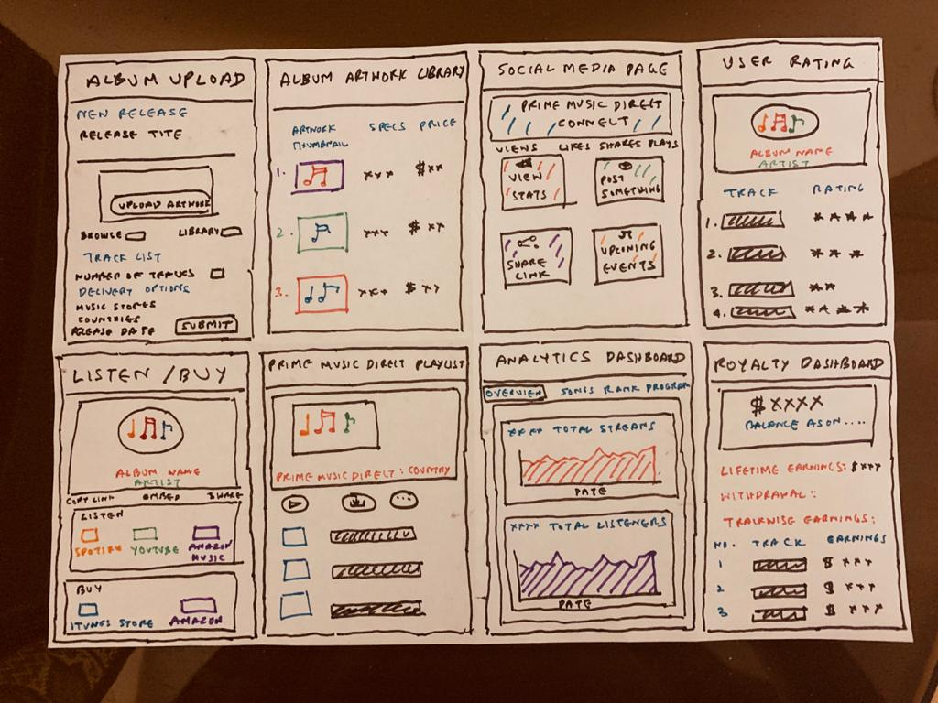
8 Sketches

Slide 16
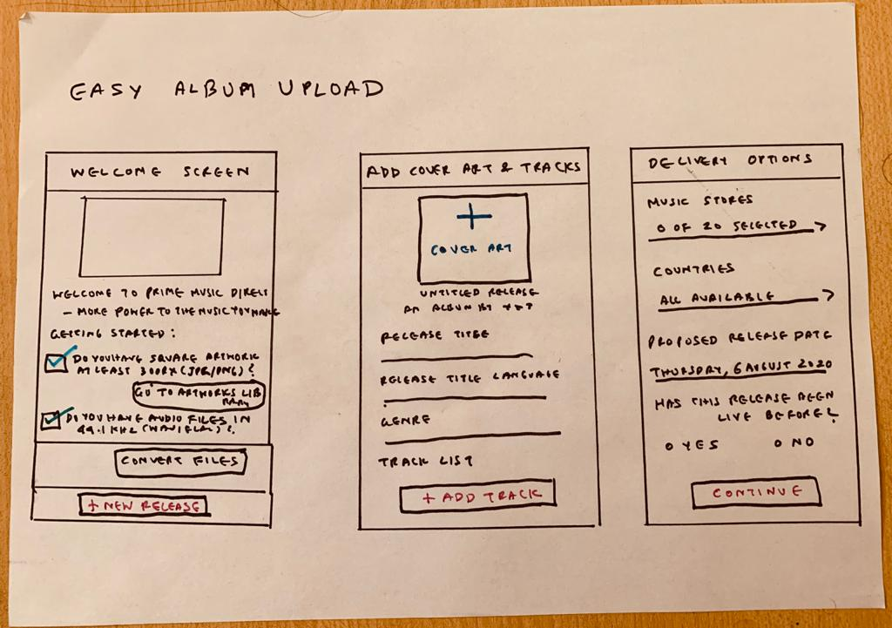
Solution Sketch 1

Slide 17
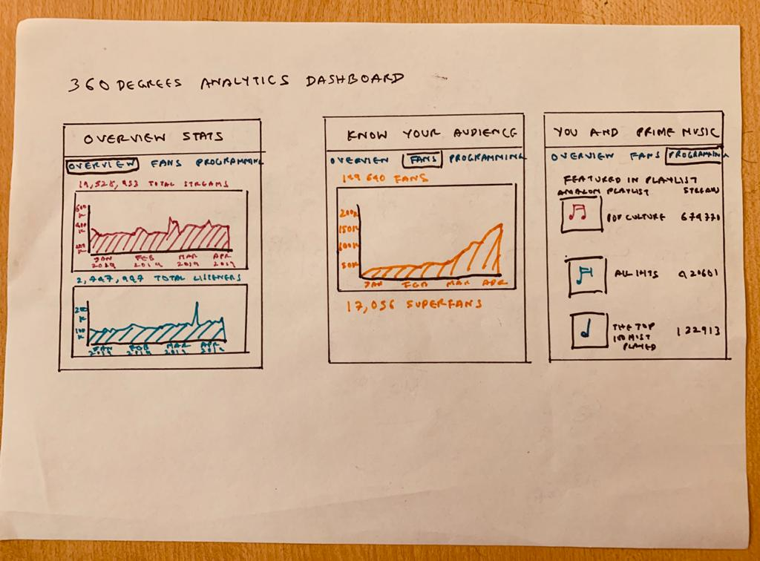
Solution Sketch 2

Slide 18
Decide
Pick the final concept that you develop into a prototype
© 2019 Udacity. All rights reserved.
Notes:
[ALL PARTICIPATION]

Slide 19
Decision
Decision | Easy Album Upload
Rationale | As mentioned in the PRD, the problem we are trying to solve and the market we are addressing involve the Artists Direct segment – independent songwriters and artists who would come to our platform to publish music free of the constraints of prevailing industry practices. It is imperative for our platform to, first and foremost, provide a smooth and user-friendly interface for uploading and distributing their music. The album upload process is a crucial part of the overall user experience that will motivate artists to come to our platform. Therefore we have chosen this solution for further development and prototyping.

Slide 20
Prototype
Turn your concept into a realistic, interactive prototype that you will use to validate your assumptions and ideas
© 2019 Udacity. All rights reserved.
Notes:
[ALL PARTICIPATION]

Slide 21

Storyboard
Link to storyboard below
(Please copy and paste in browser)
https://app.theplot.io/public-projects/35b41863-0e9d-4412-9d38-34360e0bcdfd

Slide 22

Prototype
Description High level overview of the prototype What does it do? | This is a prototype of a mobile app version of the music self-publishing platform. While the app has different functionalities, in the prototype we have laid focus on the core tasks of uploading and distributing music.
Assumptions Any assumptions within the prototype | For the plain-vanilla Prime Music Direct users mainly The user already has audio files and album artwork in required format Uploading album artwork, audio files and choosing the distribution network comprise the most important tasks to be performed in the app and hence interactivity added to these functions mainly
Tasks What are the tasks that a user can complete in the prototype? | Sign in and start a new release On release page tap on button for adding album artwork and go to the point of choosing album artwork from iCloud etc. On release page tap on individual track and go to page for adding info On track info page tap on button for adding audio file and go to the point of choosing file from iCloud etc. On release page tap on Delivery Options and go to page listing music services to distribute album to Press submit button and go to post-upload album status page
Link to Figma prototype below:
Please copy and paste in browser
https://www.figma.com/file/67UP8vEkfITK7YEsUZ166Q/PrimeMusic-Direct?node-id=12%3A10

Slide 23
Validate
Users will go through your prototype and provide feedback on your concept. This is also an opportunity to have an engineering feasibility discussion
© 2019 Udacity. All rights reserved.
Notes:
[ALL PARTICIPATION]

Slide 24
Plan and recruit for research
Research Plan

Slide 25

User Testing
Link to
notes
Link to audio recording
Key Findings from Participant 1
What worked well | The participant was able to navigate the interface well and complete all the tasks.
Where participants got stuck | The participant was not able to clearly distinguish between features for Prime Music Direct ( the plain vanilla offering) and those exclusively for Prime Music Select (the augmented offering) like social media support.
Other observations | The participant especially liked the intuitive interface but felt that the design looked a bit old.

Slide 26
User Testing
Link your
notes
Link your audio recording
Key Findings from Participant 2
What worked well | The participant was able to navigate the interface well and complete all tasks
Where participants got stuck | Since the participant is not a practising musician she was not able to articulate what additional features beyond those present in the app a musician would want to have.
Other observations | The participant especially like the feature for splitting royalties and the ability to view royalty details in the app as she felt it was an important feature for a user.

Slide 27
Improvements
Improvement #1 | Make the colour schemes, text fonts more contemporary. Add sections for stats and royalty tracker.
Rationale | Both users observed that the look and feel could be enhanced with better colours and fonts. Since they belong to the age group 20-30, it would make sense to change colour schemes, etc. to appeal more to the younger age group.
Improvement #2 | Enhance sections in the app for stats and royalty tracker.
Rationale | Both users were excited about the stats and royalty sections they saw an overview of. So it would make sense to enhance these sections in the app in future.

Slide 28
Handoff
© 2019 Udacity. All rights reserved.
Notes:
[ALL PARTICIPATION]

Slide 29
Updated PRD
Link to PRD V2

